Slide 1
THE GOOD, THE BAD
AND THE UGLY
The wrong patient, the wrong procedure…
or the wrong outcome?
Caterina Conte, MD, PhD
IRCCS MultiMedica, Milan · San Raffaele Roma University, Rome

Slide 2
CAN WE PREDICT THE “GOOD” PATIENT?
SOPHIA: interpretable prediction of 5-year weight trajectories after bariatric surgery
7 predictors selected from 434 baseline variables
10,231
2.8 kg/m²
HEIGHT
WEIGHT
PROCEDURE
PATIENTS · 12 CENTRES · 10 COUNTRIES
MEDIAN ABSOLUTE ERROR AT 5 YEARS
AGE
DIABETES
DIABETES DURATION
SMOKING
Saux P, et al. Lancet Digit Health. 2023;5:e692–e702. doi:10.1016/S2589-7500(23)00135-8
Abbreviations: BMI, body mass index; SOPHIA, name of the prediction model.

Slide 3
CAN WE PREDICT THE “GOOD” PATIENT?
SOPHIA: interpretable prediction of 5-year weight trajectories after bariatric surgery
7 predictors selected from 434 baseline variables
10,231
2.8 kg/m²
HEIGHT
WEIGHT
PROCEDURE
PATIENTS · 12 CENTRES · 10 COUNTRIES
MEDIAN ABSOLUTE ERROR AT 5 YEARS
AGE
DIABETES
DIABETES DURATION
SMOKING
PREDICTING WEIGHT ≠ SELECTING THE BEST TREATMENT
Prediction can calibrate expectations — it does not capture every disease-specific trade-off.
Saux P, et al. Lancet Digit Health. 2023;5:e692–e702. doi:10.1016/S2589-7500(23)00135-8
Abbreviations: BMI, body mass index; SOPHIA, name of the prediction model.

Slide 4
RED FLAGS ARE OUTCOME-SPECIFIC
A red flag should change the decision — not automatically exclude the patient
GI
GERD / BARRETT
IBD
IBD / CROHN
Procedure choice
Anatomy & bowel length
BMI
VERY HIGH BMI
WHAT MATTERS
MOST?
STONE
NEPHROLITHIASIS
Required efficacy
Malabsorptive risk
T2D
LONG-STANDING T2D
NUTR
NUTRITION / FOLLOW-UP
Expected remission
Acceptable “price”
A RED FLAG IS NOT NECESSARILY A CONTRAINDICATION. IT IS A DECISION MODIFIER.
Eisenberg D, et al. Obes Surg. 2023;33:3–14. • Kumar SS, et al. Surg Endosc. 2025;39:1–10. doi:10.1007/s00464-024-11433-2
Abbreviations: BMI, body mass index; GERD, gastro-oesophageal reflux disease; IBD, inflammatory bowel disease; T2D, type 2 diabetes.

Slide 5
CASE 1 — “SHE WANTS A SLEEVE”
The easiest bad match?
42 YEARS
BMI 38 kg/m²
Daily GERD
PPI-dependent
Erosive oesophagitis
“I want a sleeve.
It is less invasive.”
STILL A SLEEVE?
Patient preference matters.
Abbreviations: BMI, body mass index; GERD, gastro-oesophageal reflux disease; PPI, proton-pump inhibitor; RYGB, Roux-en-Y gastric bypass; SG, sleeve gastrectomy.

Slide 6
CASE 1 — “SHE WANTS A SLEEVE”
The easiest bad match?
SLEEVEPASS — 10 YEARS
42 YEARS
GERD worsened
BMI 38 kg/m²
Daily GERD
PPI-dependent
Erosive oesophagitis
SG
49%
RYGB
9%
PPI use
SG
64%
RYGB
36%
“I want a sleeve.
It is less invasive.”
Oesophagitis
SG
31%
49%
BARRETT
4% vs 4%
RYGB
7%
STILL A SLEEVE?
64%
Patient preference matters.
Informed preference requires knowing the trade-off.
Salminen P, et al. JAMA Surg. 2022;157:656–666. doi:10.1001/jamasurg.2022.2229
Abbreviations: BMI, body mass index; GERD, gastro-oesophageal reflux disease; PPI, proton-pump inhibitor; RYGB, Roux-en-Y gastric bypass; SG, sleeve gastrectomy.

Slide 7
NOT ALL BYPASSES ARE THE SAME
YOMEGA 5-year randomized extension
% excess BMI loss:
OAGB non-inferior to RYGB at 5 years
✓
Robert M, et al. Lancet Diabetes Endocrinol. 2024;12:267–276. doi:10.1016/S2213-8587(24)00035-4
Abbreviations: GERD, gastro-oesophageal reflux disease; OAGB, one-anastomosis gastric bypass; RYGB, Roux-en-Y gastric bypass.

Slide 8
NOT ALL BYPASSES ARE THE SAME
YOMEGA 5-year randomized extension
% excess BMI loss:
OAGB non-inferior to RYGB at 5 years
✓
RYGB
OAGB
18%
41%
8%
clinical GERD at 5 y
clinical GERD at 5 y
converted to RYGB
If reflux is the red flag, “bypass” is not a sufficient answer.
Important: severe GERD and Barrett oesophagus were exclusion criteria.
Robert M, et al. Lancet Diabetes Endocrinol. 2024;12:267–276. doi:10.1016/S2213-8587(24)00035-4
Abbreviations: GERD, gastro-oesophageal reflux disease; OAGB, one-anastomosis gastric bypass; RYGB, Roux-en-Y gastric bypass.

Slide 9

CASE 2 — MAXIMUM EFFICACY… AT WHAT PRICE?
BMI 56 kg/m²
10+ YEARS
20.0%
RYGB
TWL
33.9%
DS
TWL
EFFICACY
Salte OBK, et al. JAMA Netw Open. 2024;7:e2414340. doi:10.1001/jamanetworkopen.2024.14340
Abbreviations: BMI, body mass index; DS, duodenal switch; RYGB, Roux-en-Y gastric bypass; TWL, total weight loss.

Slide 10
CASE 2 — MAXIMUM EFFICACY… AT WHAT PRICE?
BMI 56 kg/m²
10+ YEARS
THE PRICE
20.0%
severe protein-calorie
malnutrition after DS
RYGB
14%
TWL
33.9%
DS
TWL
10%
revision for malnutrition
EFFICACY
↑ vitamin deficiencies ↑ adverse events
POOR SUPPLEMENT ADHERENCE
MISSED FOLLOW-UP
STILL THE “MOST EFFECTIVE” PROCEDURE?
Salte OBK, et al. JAMA Netw Open. 2024;7:e2414340. doi:10.1001/jamanetworkopen.2024.14340
Abbreviations: BMI, body mass index; DS, duodenal switch; RYGB, Roux-en-Y gastric bypass; TWL, total weight loss.

Slide 11
CASE 2 — TOO LATE FOR METABOLIC SURGERY?
Long-standing diabetes: poor remission probability or poor candidate?
58 YEARS
BMI 41 kg/m²
T2D × 17 years
Basal–bolus insulin
HbA₁c 8.4%
“What is my chance
of diabetes remission?”
Salminen P, et al. JAMA Surg. 2022;157:656–666. doi:10.1001/jamasurg.2022.2229
Abbreviations: BMI, body mass index; HbA1c, glycated haemoglobin; T2D, type 2 diabetes.

Slide 12
CASE 2 — TOO LATE FOR METABOLIC SURGERY?
Long-standing diabetes: poor remission probability or poor candidate?
T2D REMISSION AT 10 YEARS BY BASELINE DURATION
58 YEARS
52%
12/23
BMI 41 kg/m²
T2D × 17 years
Basal–bolus insulin
HbA₁c 8.4%
25%
12/48
“What is my chance
of diabetes remission?”
0%
0/9
0–2 years
>2–10 years
>10 years
LOW REMISSION PROBABILITY ≠ BAD CANDIDATE
Maybe the wrong endpoint.
Salminen P, et al. JAMA Surg. 2022;157:656–666. doi:10.1001/jamasurg.2022.2229
Abbreviations: BMI, body mass index; HbA1c, glycated haemoglobin; T2D, type 2 diabetes.

Slide 13
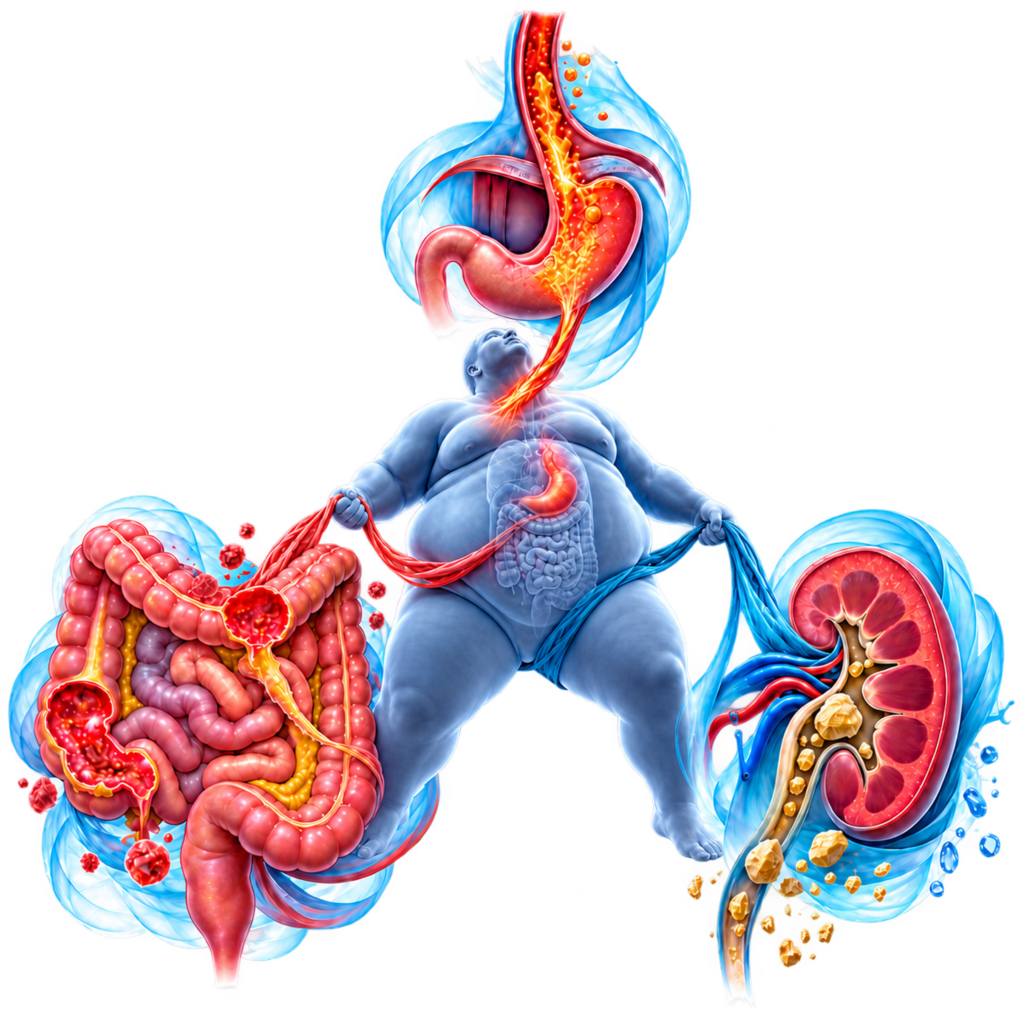
THE UGLY — EVERY OPTION HAS A PRICE
Severe GERD + Crohn disease + recurrent nephrolithiasis
GERD
severe
pushes away from SG
CROHN
STONES
IBD
recurrent
caution with bypass /
malabsorptive anatomy
pushes away from RYGB
NOW
WHAT?
*IBD recommendation is conditional and based on very low-certainty evidence.
Which red flag wins?
SAGES guideline. doi:10.1007/s00464-024-11433-2 • Hoffman K, et al. J Gastrointest Surg. 2023;27:2336–2341. doi:10.1007/s11605-023-05849-9
Abbreviations: GERD, gastro-oesophageal reflux disease; IBD, inflammatory bowel disease; RYGB, Roux-en-Y gastric bypass; SAGES, Society of American Gastrointestinal and Endoscopic Surgeons; SG, sleeve gastrectomy.

Slide 14
DOES EVERY PATIENT NEED SURGERY?
Endoscopic treatment is not simply “less surgery”
LOWER INVASIVENESS / REVERSIBILITY
INCREASING EXPECTED EFFICACY / DURABILITY
IGB
ESG
MBS
Temporary
Needs an exit strategy
Organ-preserving
13.6% TBWL at 52 weeks
Highest established
efficacy / durability
DEFINITIVE TREATMENT? • BRIDGE? • PART OF A SEQUENCE? • DELAY?
ASGE–ESGE: EBMT + lifestyle can be considered for BMI ≥30, or 27–29.9 with ≥1 obesity-related comorbidity.
Abu Dayyeh BK, et al. Lancet. 2022;400:441–451. doi:10.1016/S0140-6736(22)01280-6 • Jirapinyo P, et al. Gastrointest Endosc. 2024;99:867–885.e64. doi:10.1016/j.gie.2023.12.004
Abbreviations: ASGE, American Society for Gastrointestinal Endoscopy; BMI, body mass index; EBMT, endoscopic bariatric and metabolic therapy; ESG, endoscopic sleeve gastroplasty; ESGE, European Society of Gastrointestinal Endoscopy; IGB, intragastric balloon; MBS, metabolic and bariatric surgery; TBWL, total body weight loss.

Slide 15
SURGERY OR PHARMACOTHERAPY? WRONG QUESTION.
Obesity is chronic — treatment can be sequential and additive
BEFORE MBS
AFTER MBS
BEFORE REVISION
Insufficient high-level evidence to recommend routine pre-MBS OMM
Consider OMM for suboptimal response / recurrent weight gain
Consider OMM before revisional surgery
BARI-STEP | SEMAGLUTIDE 2.4 mg | 68 WEEKS
−18.0%
+0.4%
SEMAGLUTIDE GROUP
85%
≥10% WL
62%
≥15% WL
WEIGHT CHANGE WITH SEMAGLUTIDE
WEIGHT CHANGE WITH PLACEBO
47%
≥20% WL
No new post-bariatric safety signal
ADDING MEDICATION AFTER SURGERY IS NOT EVIDENCE OF SURGICAL FAILURE.
It is chronic disease management.
Cohen RV, et al. BJS. 2024;111:znae283. doi:10.1093/bjs/znae283 • Stanley C, et al. Nat Med. 2026;32:2662–2672. doi:10.1038/s41591-026-04416-4
Abbreviations: BARI-STEP, randomized trial of semaglutide 2.4 mg after bariatric surgery with suboptimal clinical response; MBS, metabolic and bariatric surgery; OMM, obesity management medication; WL, weight loss.

Slide 16
RED FLAGS SHIFT THE BALANCE
A practical discussion matrix — not a prescriptive algorithm
RED FLAG
PUSHES TOWARD…
PUSHES AWAY FROM…
WHY?
Significant GERD / Barrett
RYGB
SG; caution OAGB
Reflux / oesophagitis / bile reflux
IBD / Crohn
Often SG*
Bypass-type procedures*
Preserve bowel / intestinal length
Recurrent nephrolithiasis
Lower malabsorptive burden
RYGB; caution highly malabsorptive procedures
Hyperoxaluria / stone risk
Very high BMI / maximal WL
Higher-efficacy treatment ± OMM
—
Efficacy matters — but so does burden
Nutritional vulnerability / poor follow-up
Lower malabsorptive burden
DS/SADI-S; caution bypass
Deficiency / protein malnutrition
Long-standing T2D
MBS may still be appropriate
Remission as sole definition of success
Recalibrate expectations
These are decision modifiers — not contraindications.
Evidence strength differs substantially across conditions.
*IBD: conditional SAGES recommendation; very low-certainty evidence.
Abbreviations: BMI, body mass index; DS, duodenal switch; GERD, gastro-oesophageal reflux disease; IBD, inflammatory bowel disease; MBS, metabolic and bariatric surgery; OAGB, one-anastomosis gastric bypass; OMM, obesity management medication; RYGB, Roux-en-Y gastric bypass; SADI-S, single-anastomosis duodeno-ileal bypass with sleeve gastrectomy; SAGES, Society of American Gastrointestinal and Endoscopic Surgeons; SG, sleeve gastrectomy; T2D, type 2 diabetes; WL, weight loss.

Slide 17
GOOD FOR WHOM? GOOD FOR WHAT?
The procedure is only one part of the strategy
01
Good for which outcome?
THE MOST EFFECTIVE
PROCEDURE
IS NOT NECESSARILY
THE BEST STRATEGY.
02
Good for which intervention?
03
Good now — or after optimisation?
04
At what price?
The best strategy matches the patient’s priorities — and the liabilities they can safely sustain.
05
Or is the best treatment a sequence?
PATIENT → PROCEDURE → OUTCOME → SEQUENCE
Eisenberg D, et al. Obes Surg. 2023;33:3–14. • Cohen RV, et al. BJS. 2024;111:znae283. • Cohen RV, et al. Lancet Diabetes Endocrinol. 2025;13:733–736.

Slide 18

FROM SURGERY TO SYNERGY
Multidisciplinary, 360° care

Slide 19
Thank you

